Slide 1


21 DAYS OF
MACHINE LEARNING
17/21
---Code Warriors---

Slide 2

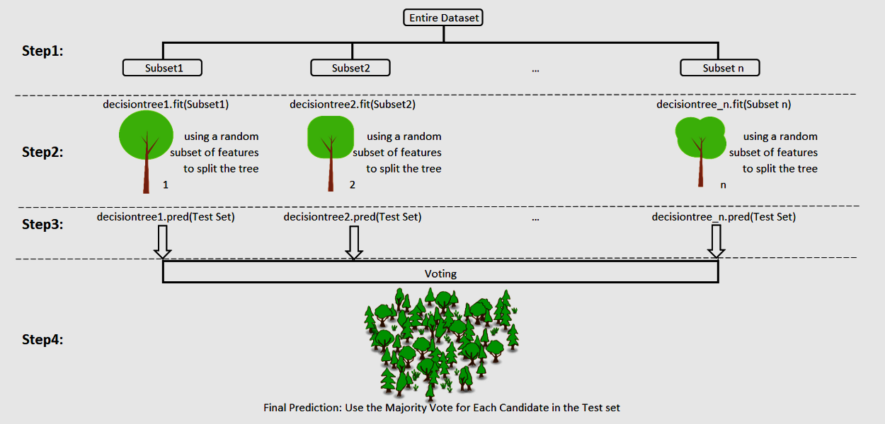
What is Random Forest Classification
It can be referred to as a ‘Forest’ of trees and hence the name “Random Forest”. The term ‘Random’ is due to the fact that this algorithm is a forest of ‘Randomly created Decision Trees’.
---Code Warriors---

Slide 3
Working of Random Forest Algorithm
Step 1: start with the selection of random samples from a given dataset.
Step 2: construct a decision tree for every sample. Then get the prediction result from every decision tree.
Step 3: voting will be performed for every predicted result.
Step 4: select the most voted prediction result as the final prediction result.
---Code Warriors---

Slide 4
Random Forest Classification Model
1
from sklearn.ensemble import RandomForestClassifier
2
classifier = RandomForestClassifier(n_estimators = 50)
3
classifier.fit(X_train, y_train)
4
y_pred = classifier.predict(X_test)
---Code Warriors---

